Slide 1
APHLIS
Postharvest loss estimates for cereals and other crops

Slide 2
The APHLIS website

Slide 3
www.aphlis.net

Slide 4
You want to know how much cereal grain is lost?
Science-based reasonable estimates are presented on the APHLIS website: www.aphlis.net
On the website you can access:
estimates of losses as tables and as interactive maps
You can also obtain information on:
the quality of these estimates
the PH situation in countries covered
the collection of PH loss data, and more…
www.aphlis.net | Postharvest loss estimates for cereals and other crops

Slide 5
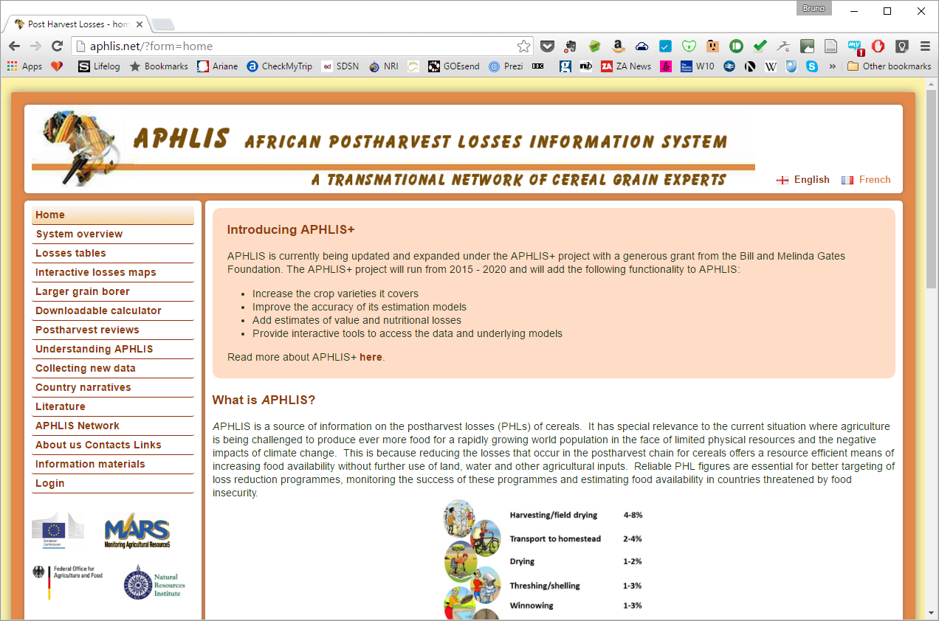
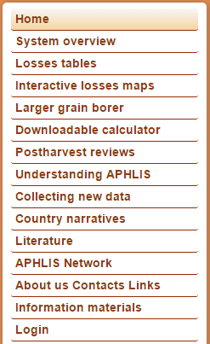
Navigation on the APHLIS website: www.aphlis.net

Slide 6
APHLIS Interactive Losses Maps

Slide 7
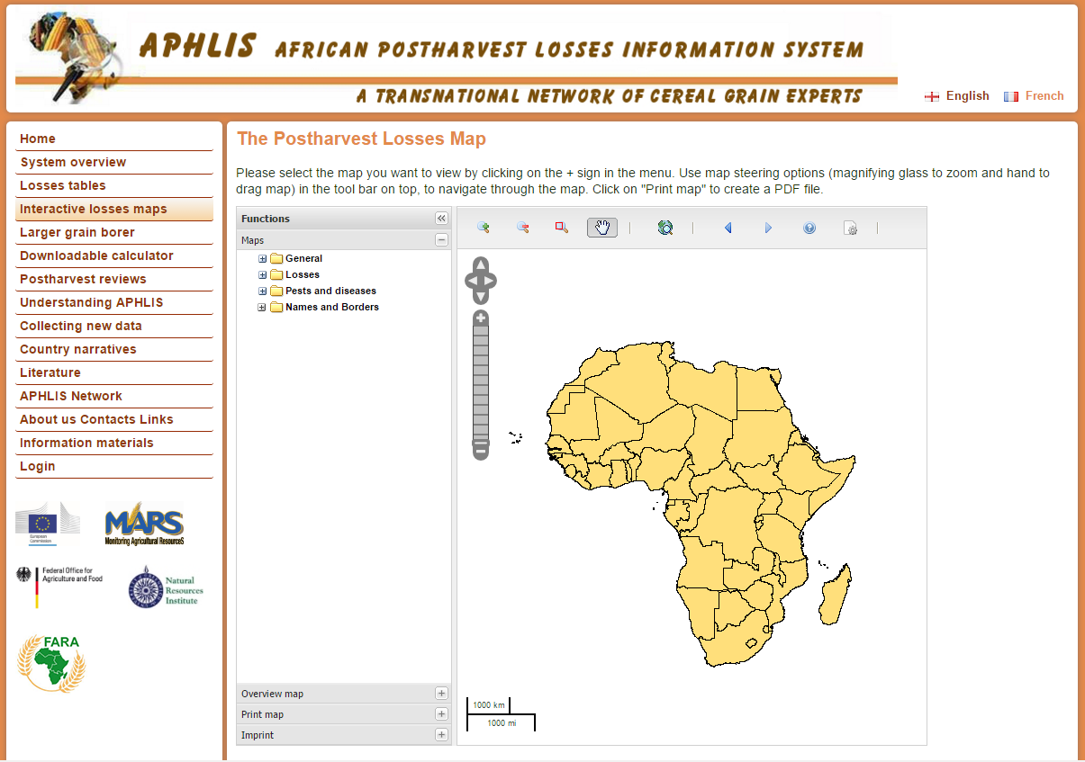
Navigation panel: select crop and year (and more)
Use the (+) symbol to display sub-choices
You can show geographical and climate info, and LGB pest reports
www.aphlis.net | Postharvest loss estimates for cereals and other crops

Slide 8
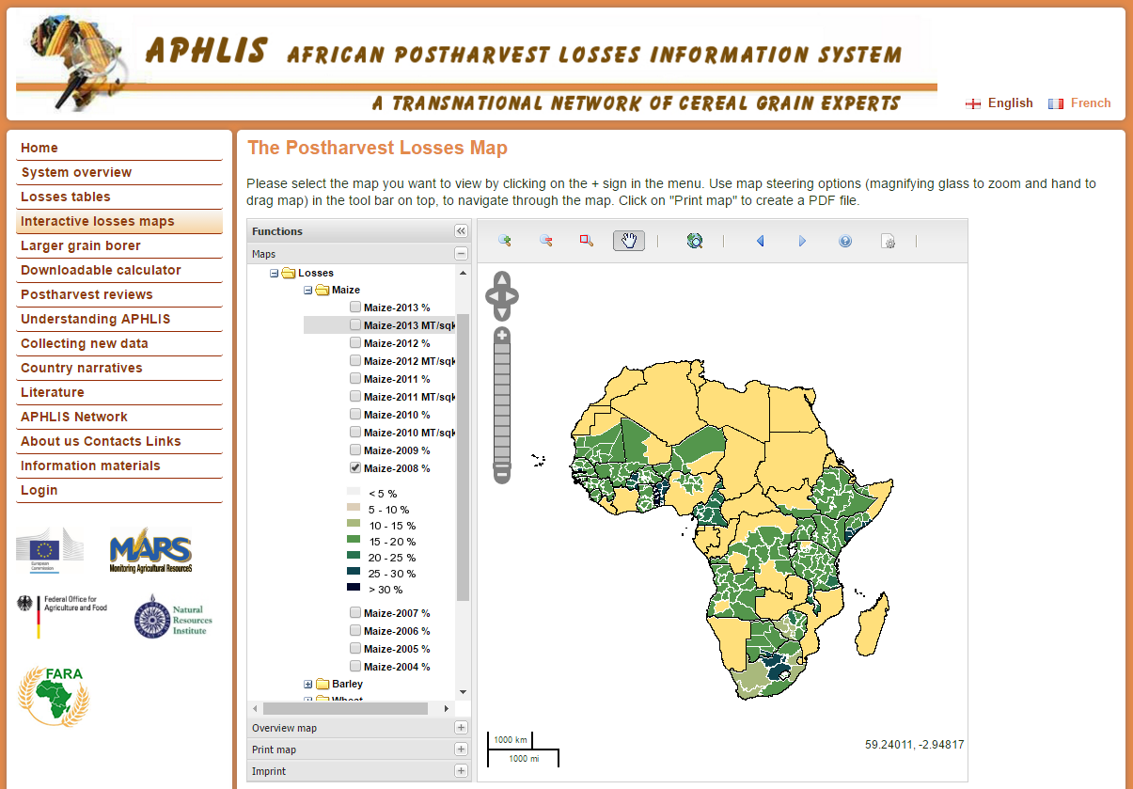
Example: % losses for maize in 2008
www.aphlis.net | Postharvest loss estimates for cereals and other crops

Slide 9
Zoom and pan
www.aphlis.net | Postharvest loss estimates for cereals and other crops

Slide 10
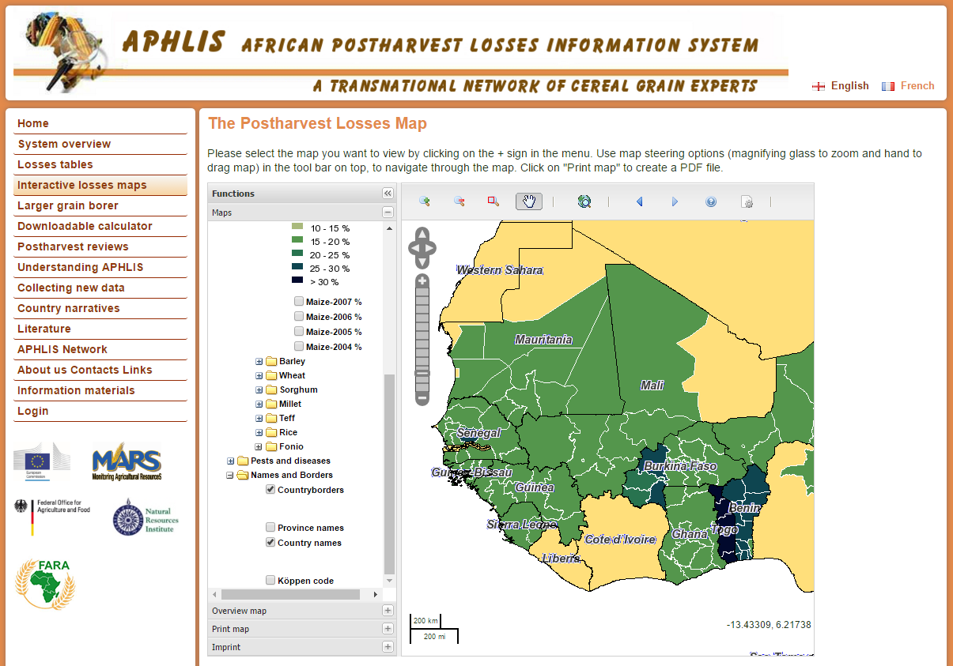
Country names
www.aphlis.net | Postharvest loss estimates for cereals and other crops

Slide 11
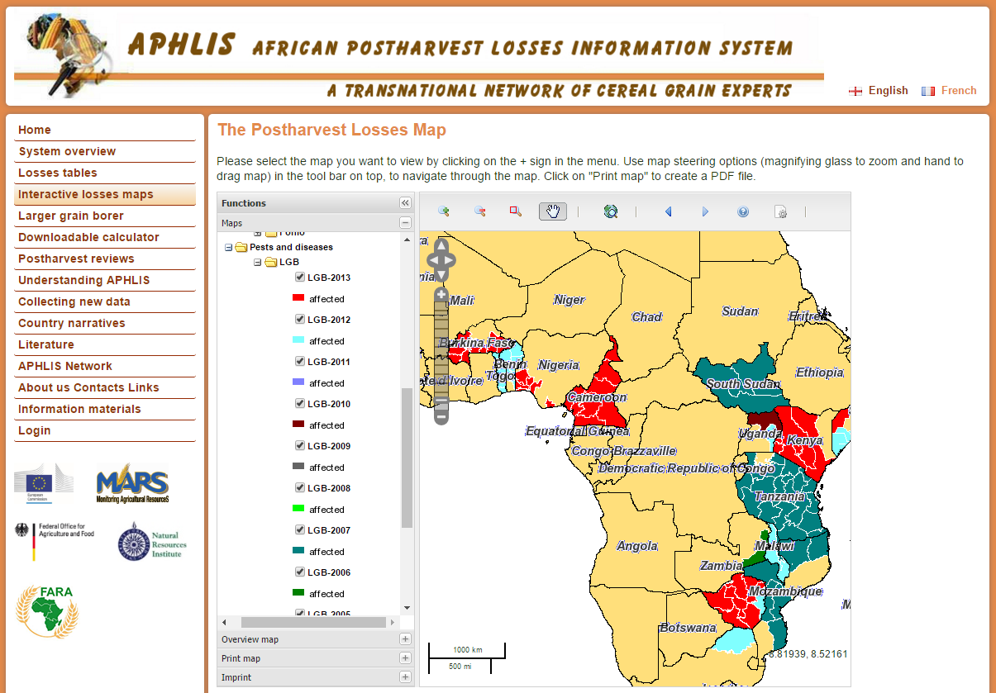
LGB reports, by year
Export map as PDF to print
www.aphlis.net | Postharvest loss estimates for cereals and other crops

Slide 12
Losses presented in tables

Slide 13
Years
Select a crop
www.aphlis.net | Postharvest loss estimates for cereals and other crops

Slide 14
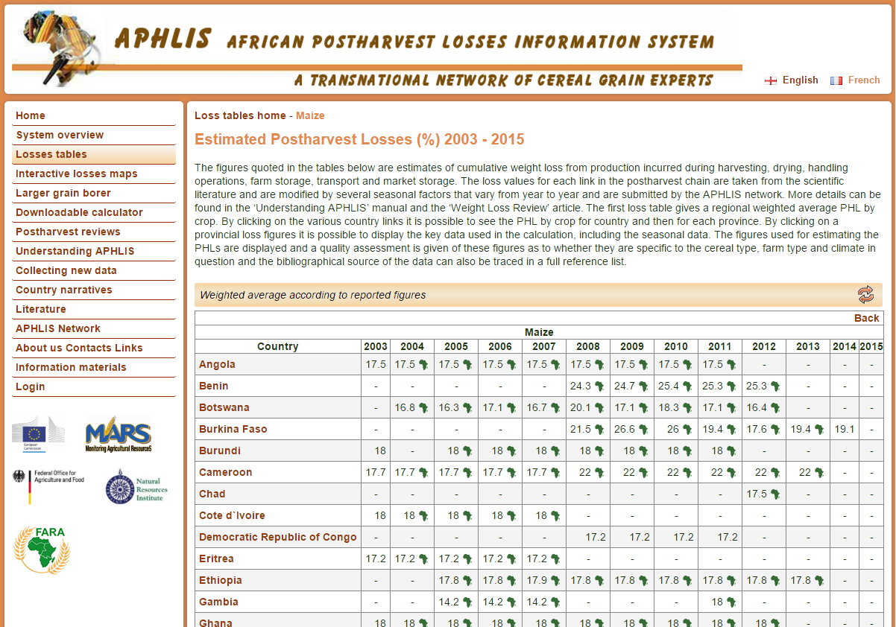
Hover on figure to show map
Select country
www.aphlis.net | Postharvest loss estimates for cereals and other crops

Slide 15
Provinces within selected country
Select a % loss figure to see the underlying details
www.aphlis.net | Postharvest loss estimates for cereals and other crops

Slide 16
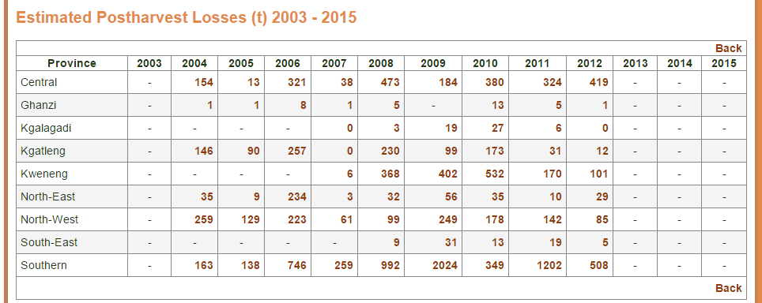
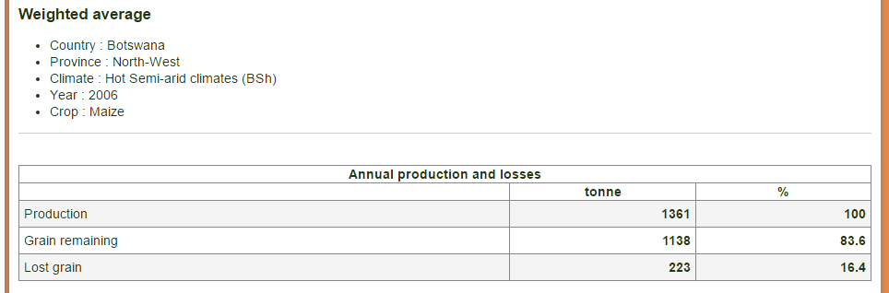
Losses expressed in tonnes, by province
Provincial production and losses
www.aphlis.net | Postharvest loss estimates for cereals and other crops

Slide 17
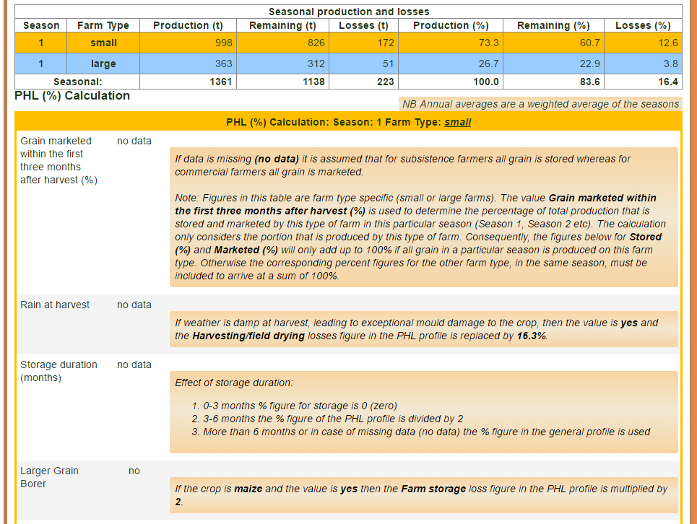
Figures for small scale farms and industrial farms
Country-specific factors used to adjust the PH profile of the agro-ecological zone

Slide 18
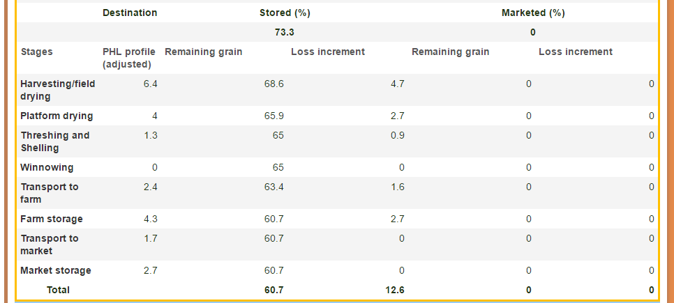
Links of the value chain from harvest to market
PHL profile adjusted from the agro-ecological zone
Grain remaining and loss increment
www.aphlis.net | Postharvest loss estimates for cereals and other crops

Slide 19
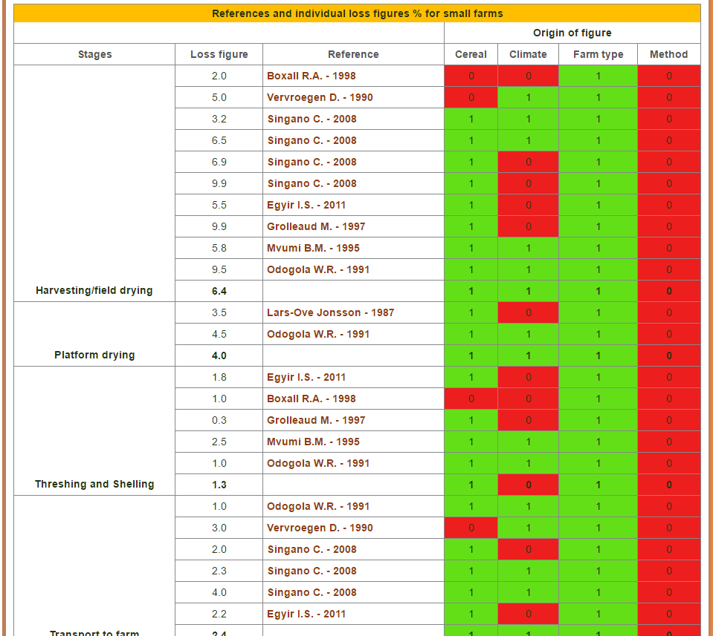
Links of the value chain from harvest to market
% loss value from literature and reference
Quality judgement: how reliable is the published figure?

Slide 20
More from the APHLIS website

Slide 21
Background review articles to download
www.aphlis.net | Postharvest loss estimates for cereals and other crops

Slide 22
APHLIS manual and comprehensive introduction
www.aphlis.net | Postharvest loss estimates for cereals and other crops

Slide 23
How to collect new loss data, with downloadable manual

Slide 24
Country narratives offer background information on PH losses for the country
Example: Rwanda
www.aphlis.net | Postharvest loss estimates for cereals and other crops

Slide 25
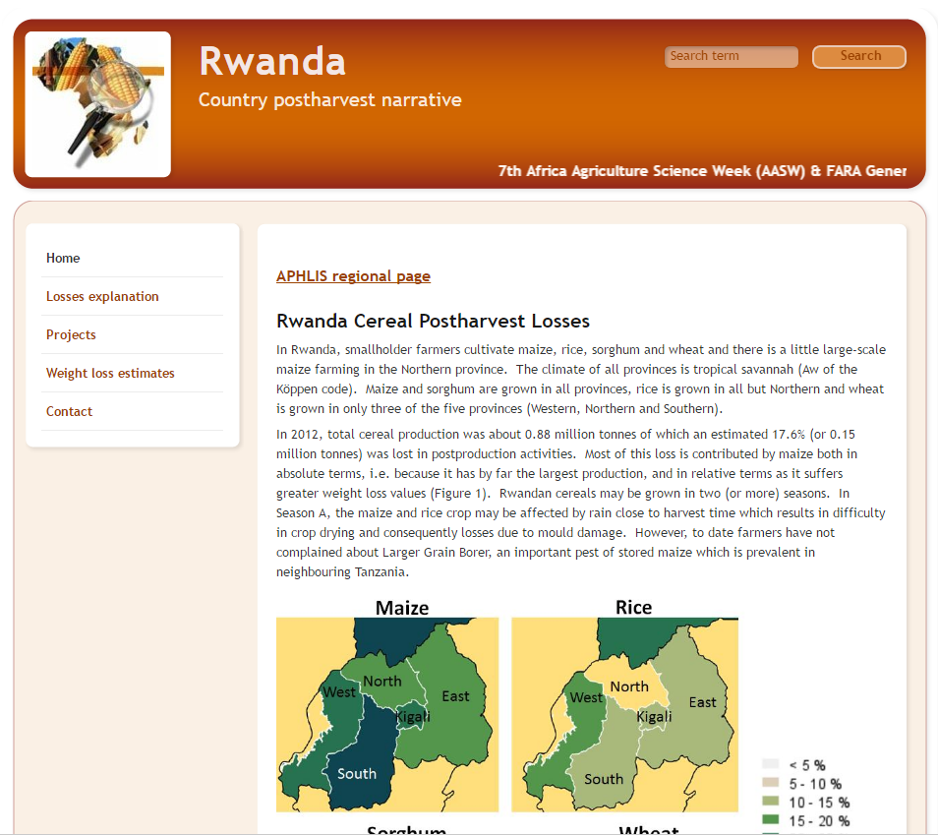

Slide 26
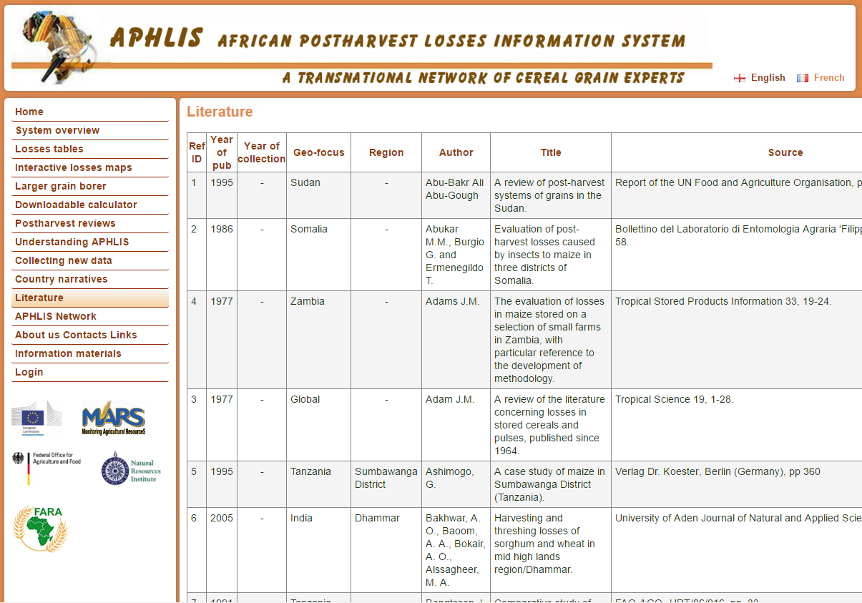
Detailed references of literature used
www.aphlis.net | Postharvest loss estimates for cereals and other crops

Slide 27
List of PH experts by country
www.aphlis.net | Postharvest loss estimates for cereals and other crops

Slide 28
The future of APHLIS
APHLIS+ is a 5 years project to make APHLIS even better. It is funded by:
www.aphlis.net | Postharvest loss estimates for cereals and other crops

Slide 29
To improve APHLIS, the Bill & Melinda Gates Foundation has funded the new “APHLIS+” project
APHLIS+ will:
Increase the type of crops covered
Improve the accuracy of the estimation model
Add estimates of value and nutritional losses
Update the user interface
Add warning systems on risks of LGB or aflatoxin
Further develop the network of experts
www.aphlis.net | Postharvest loss estimates for cereals and other crops

Slide 30
www.aphlis.net

