Slide 1


APHLIS⁺
The African Postharvest Losses Information System

Slide 2
What we will cover
What is APHLIS?
What does APHLIS offer?
Components of APHLIS
The downloadable calculator
What is APHLIS⁺?

Slide 3
What is APHLIS?
APHLIS estimates the % postharvest weight loss of cereal grains in Sub-Saharan Africa. It -
Is based on a network of local experts who submit seasonal observations
Gives loss estimates by cereal, by country and by province
Loss estimates are updated annually
Is fully transparent for the method of calculation and the data used, and
Can improve over time as better loss data can easily be added to the system

Slide 4
What does APHLIS offer?
APHLIS loss estimates can be used to -
Support agricultural policy formulation
Identify opportunities to improve value chains
Improve food security (cereal supply estimates)
Monitor and evaluate loss reduction activities

Slide 5

APHLIS African Network of Experts
>30 African experts
Provide seasonal factors to increase accuracy of estimates (e.g. damp weather at harvest, % of crop retained for farm storage, length of storage period, number of harvest, LGB infestation)
Provide seasonal crop data
Provide “country narratives” to give context
APHLIS champions
Notes:
The network is being refreshed and revived at the start of the 5 years APHLIS+ project
And that new experts will be invited to join, for the new commodities

Slide 6
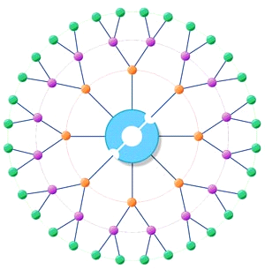

APHLIS Database
Network of local experts
PHL database
Stores key data
  Production/yield
  Rainfall
  Climatic extremes etc
Is accessible by network
Annual up-dates

Slide 7

APHLIS Calculator
PHL database
PHL calculator
Estimates cumulative weight loss from production
Uses figures for loss from literature and from network

Slide 8

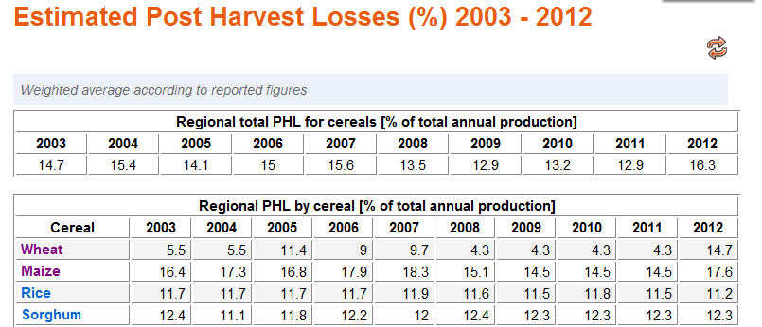
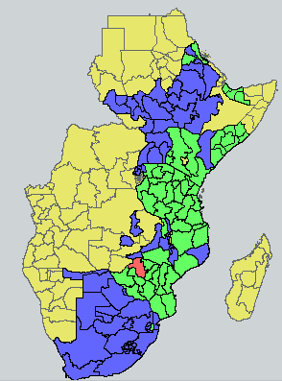
The APHLIS website – www.aphlis.net
The website displays PHL estimates and key data
Losses by crop country & provinces
Maps of PHLs & other data

Slide 9

Available downloads
User guide & other documents
PHL calculator spreadsheet
Losses data tables
Losses maps
Allows users to enter own figures

Slide 10
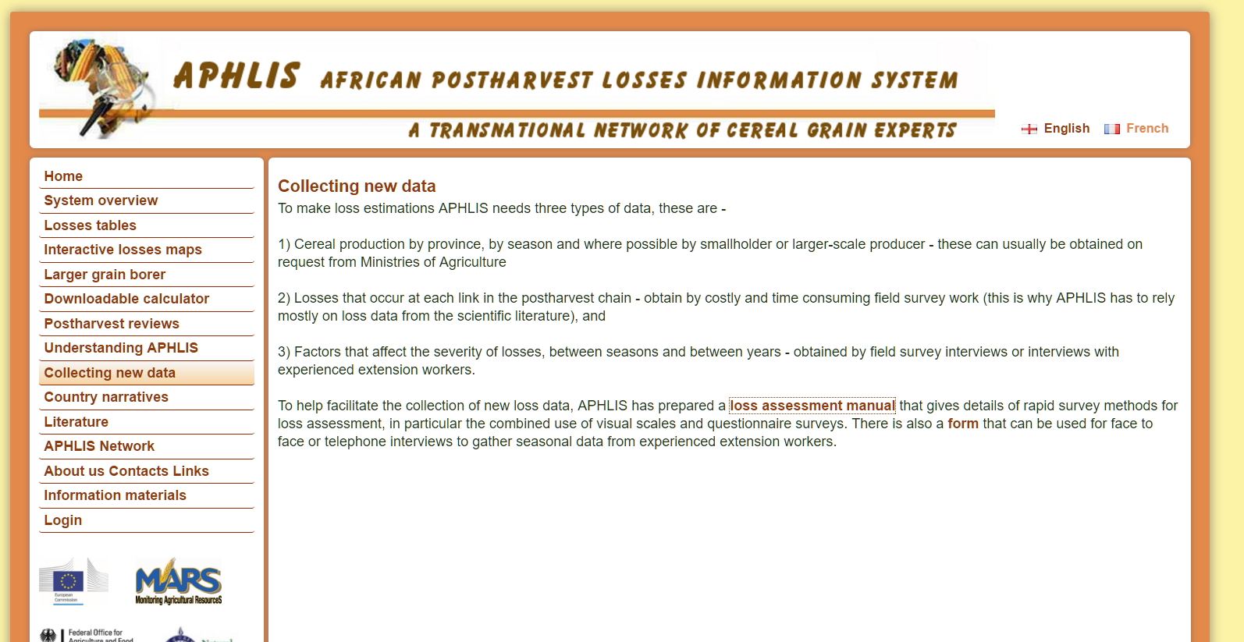
Accessing APHLIS loss estimates
Two ways to get PHL estimates
Consult the tables and/or maps on the website for losses by region, country or province
Download the PHL Calculator spreadsheet to enter user-preferred values for losses at a user defined geographical scale

Slide 11
Loss tables
Regional losses for all cereals and by cereal type
Click

Slide 12
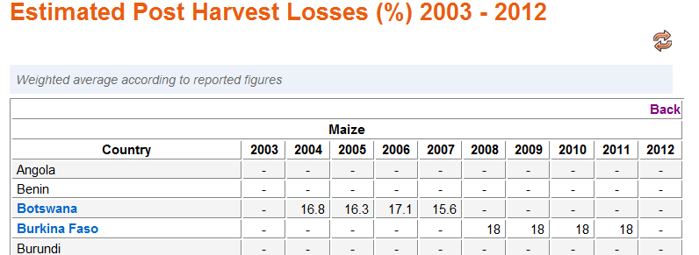
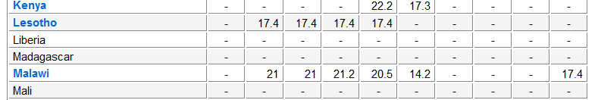
Loss tables by cereal type and country
Click

Slide 13
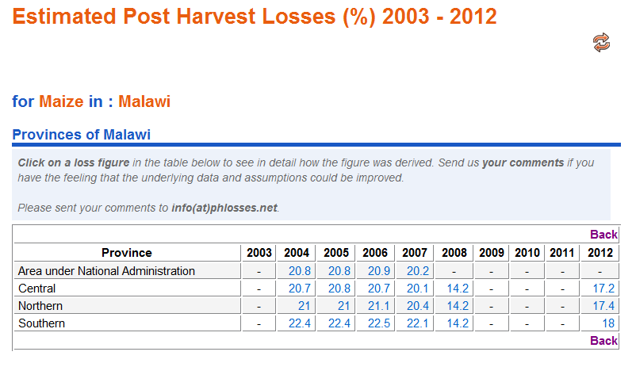
Loss tables by cereal type and province
Click on one of these figures
to get details of the loss calculation

Slide 14
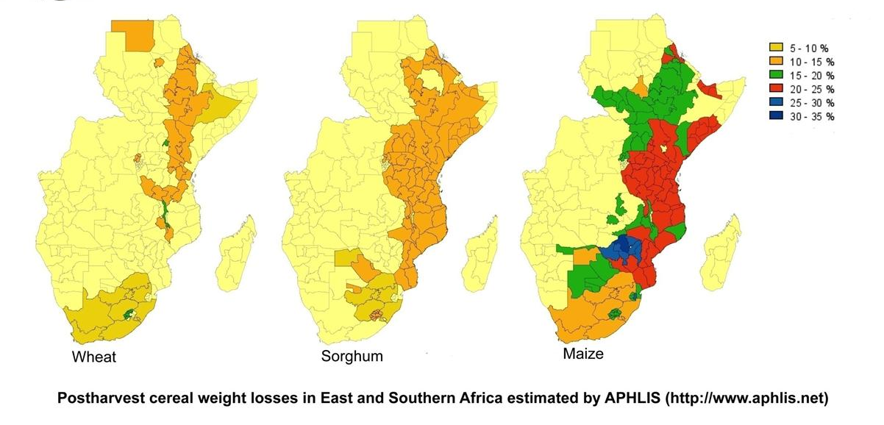
The PHLs are also displayed on maps

Slide 15
The downloadable calculator
An Excel spreadsheet where you can enter your own seasonal factors

Slide 16
The downloadable calculator
The downloadable calculator is available to give estimates at a scale below province.
Add your own data to the calculator easily
If you know the weights of threshed grain available the calculator can estimate grain production
Use the calculator to evaluate loss reductions in projects or to model ‘what if’ situations

Slide 17
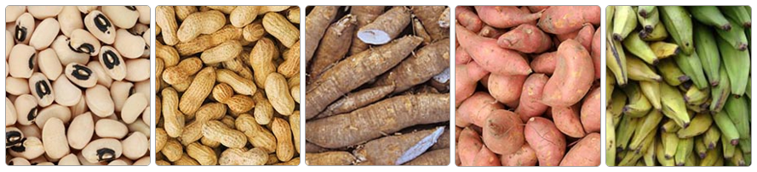
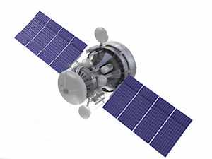
What is APHLIS⁺? A bigger and better APHLIS
Wider coverage
  Additional crops
  Financial loss estimates
  Nutritional loss estimates
New partnerships
APHLIS Steering Committee of international experts
APHLIS Technical Board for validating:
  Data collection
  Algorithms/models
Connection to numerous PHL communities of practice (especially FAO initiative)
Improved estimates
  Postharvest risk warnings (e.g. LGB or aflatoxin)
  New losses algorithms
  Better data collection
  Improved user interface
  Further development of the network of experts
  APHLIS+ is funded by the
Notes:
The 3 areas of improvement and growth for APHLIS+:
More
Better
New friends
Note: say “Financial loss ESTIMATES” and “Nutritional loss ESTIMATES”

Slide 18
Expanding APHLIS
Quantitative loss estimate (by % weight loss and tons lost)
+
Financial loss estimate
($)
+
Nutritional loss estimate
(calories and change in selected nutrients)

Slide 19
Conclusions
APHLIS is a network of local experts contributing postharvest weight loss data that are -
Transparent in the way they are calculated
Updated annually with the latest production figures
Based on the primary national unit (i.e. province)
Upgradeable as more loss data become available

Slide 20
Conclusions
APHLIS can help in -
Agricultural policy development
Identifying loss reduction priorities, and
Monitoring and evaluation of loss reduction projects

Slide 21
Conclusions
APHLIS⁺ will –
Provide wider coverage of crops
Introduce financial and nutritional loss estimates
Create new partnerships
Improve the science behind its estimates

